Slide 1

Interim Presentation
Development and Validation of a Dexterous Hand System
··· Dexhand Designed by The Robot Studio···
Team Members: Jincheng Tian, GuangTian Liu, ZhongHao Zhao
2026/4/10

Slide 2
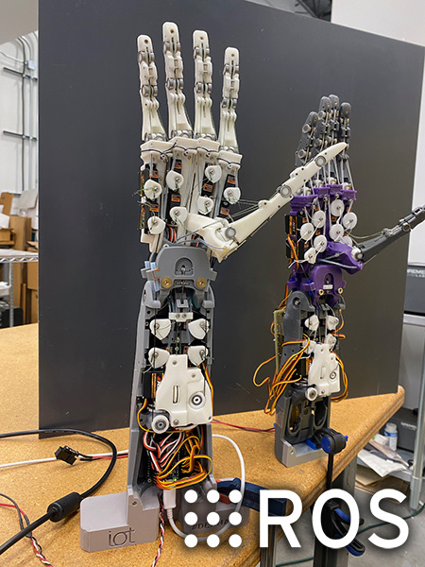
Dexhand
Project OverView
Overall Workflow
Project Background
DexHand is used in this project as an open-source dexterous hand platform
The project combines simulation, hardware implementation, and intelligent control exploration
Project Goal
Reproduce the main workflow of DexHand as a course project
Understand its mechanical, electronic, and control architecture
Prepare for later integrated testing and intelligent control development
Main Work Packages
Mechanical Assembly
Electronics and Embedded Testing
Simulation / RL Exploration
Interim Progress Focus
ROS2 simulation workflow reproduced
Hardware architecture and actuator selection analyzed
Mechanical assembly and PCB preparation started
Mechanical Assembly
Electronics & Embedded Testing
Simulation
Source: https://www.dexhand.org/
Notes:
This slide gives an overview of our DexHand project. We use DexHand as an open-source dexterous hand platform for system reproduction and validation. The project combines simulation, hardware implementation, and intelligent control exploration.
Our goal is to reproduce the main workflow of DexHand as a course project, understand its mechanical, electronic, and control architecture, and prepare for later integrated testing and intelligent control development.
At this stage, our work is divided into three main packages: mechanical assembly, electronics and embedded testing, and simulation or RL exploration.
So far, we have reproduced the ROS2 simulation workflow, analyzed the hardware architecture and actuator selection, and started mechanical assembly and PCB preparation.

Slide 3
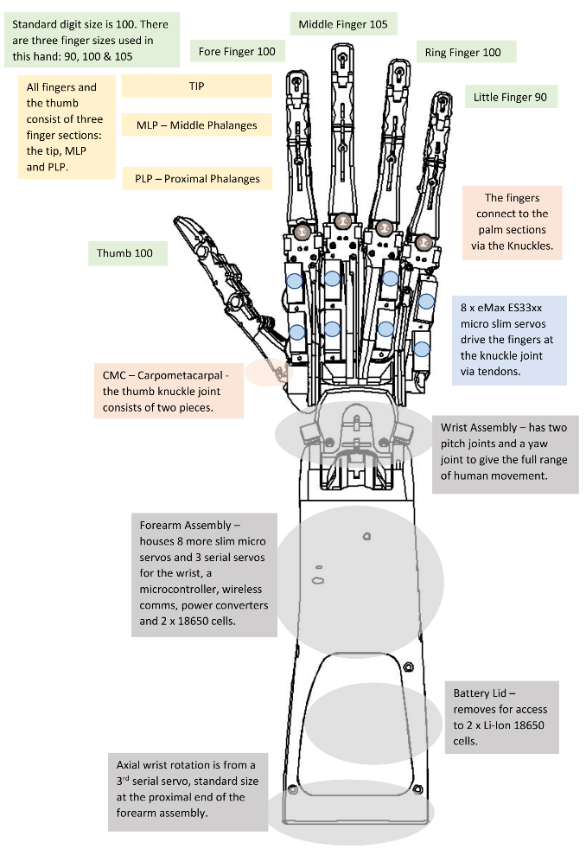
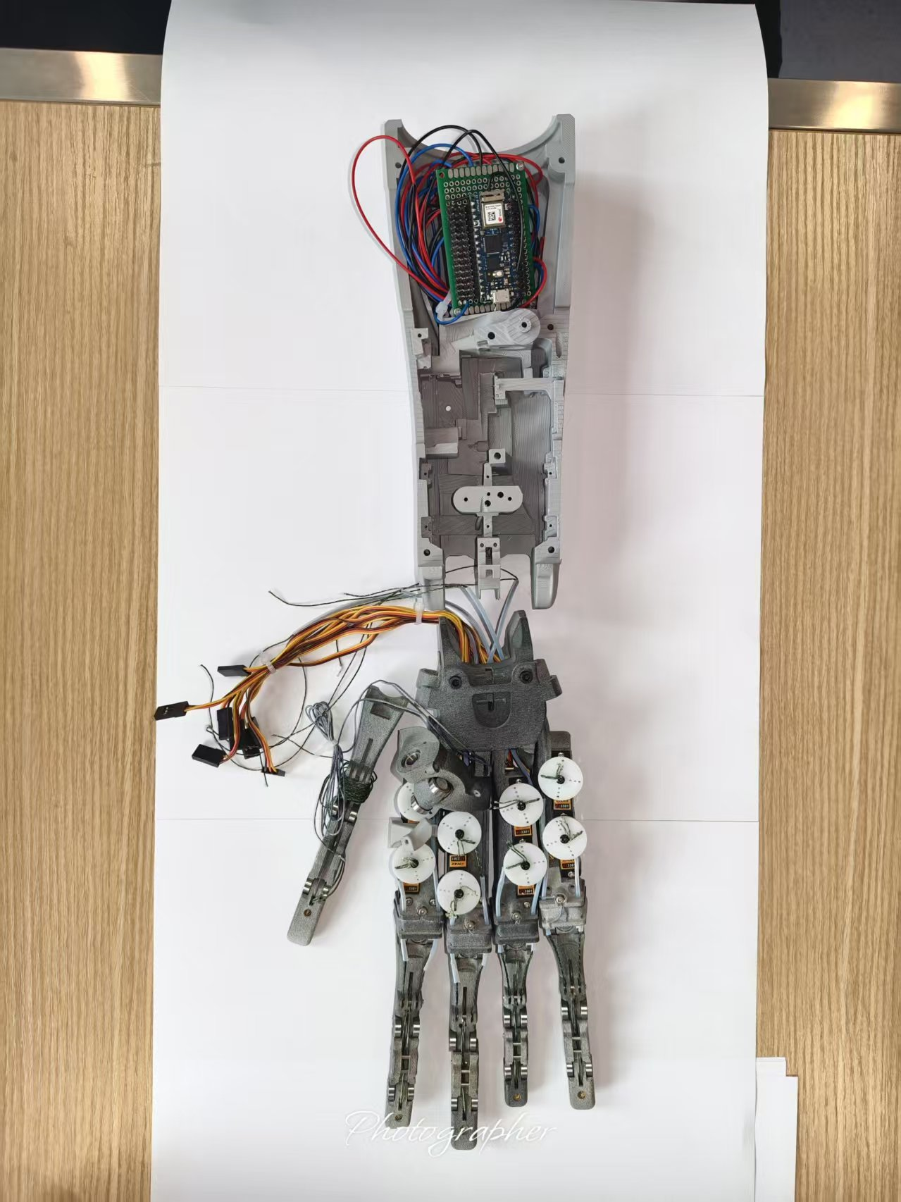
Progress
Mechanical structure
Overall Progress of Mechanical structure
Ideal Effect
Finger
100%
Palm
90%
75%
Waist
20%
Forearm
Notes:
This slide shows the overall progress of the mechanical assembly.
The image on the left presents our latest progress.
So far, about 75% of the whole structure has been completed, including the assembly of the fingers and the wrist, as well as the preparation of the forearm components.

Slide 4
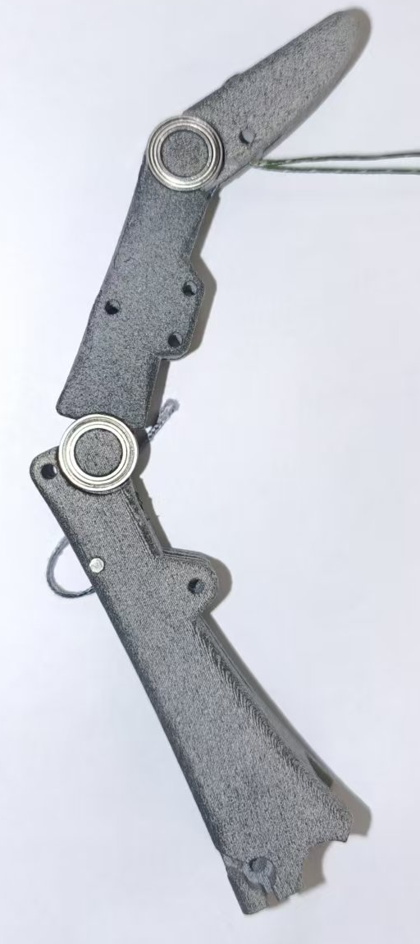
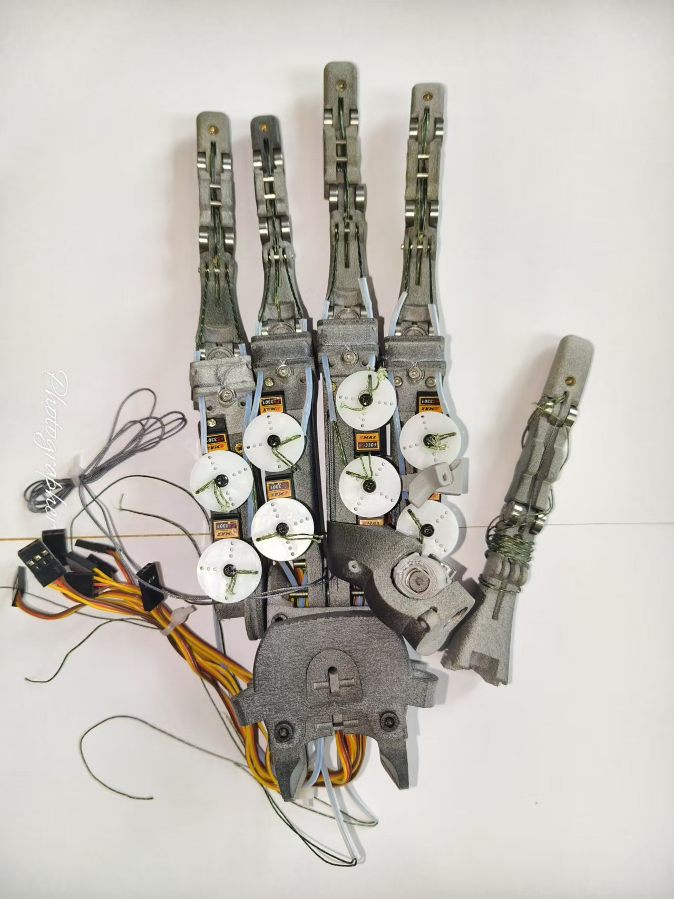
Progress
Mechanical structure
Finger & Palms & Wrist
Finger
Distal interphalangeal (DIP) joint flexion/extension → 1 DOF
Proximal interphalangeal (PIP) joint flexion/extension → 1 DOF
Metacarpophalangeal (MCP) joint flexion/extension and abduction/adduction → 2 DOF
5 fingers × 4 DOF per finger = 20 DOF
Palm
The palm houses key components such as springs and servo motors.
Springs provide the restoring force for finger motion.
Tubes protect the tendons and prevent cable entanglement.
Each finger is actuated by two servo motors for lateral motion.
Wrist
The wrist supports pitch and yaw, corresponding to 1 + 1 = 2 DOF.
Notes:
This slide shows the detailed assembly work, which mainly includes the fingers, palm, and wrist.
For the finger part, we assembled five fingers.
Each finger has four degrees of freedom, which support flexion, extension, and lateral motion.
In total, the hand has 20 degrees of freedom in the fingers.
For the wrist part, we installed several key components, such as springs and motors.
The springs help keep the hand in a straightened position, while the motors provide the driving force for the lateral movement of the fingers.
The wrist supports pitch and yaw, but it does not support rotation. Therefore, the wrist has two degrees of freedom.

Slide 5
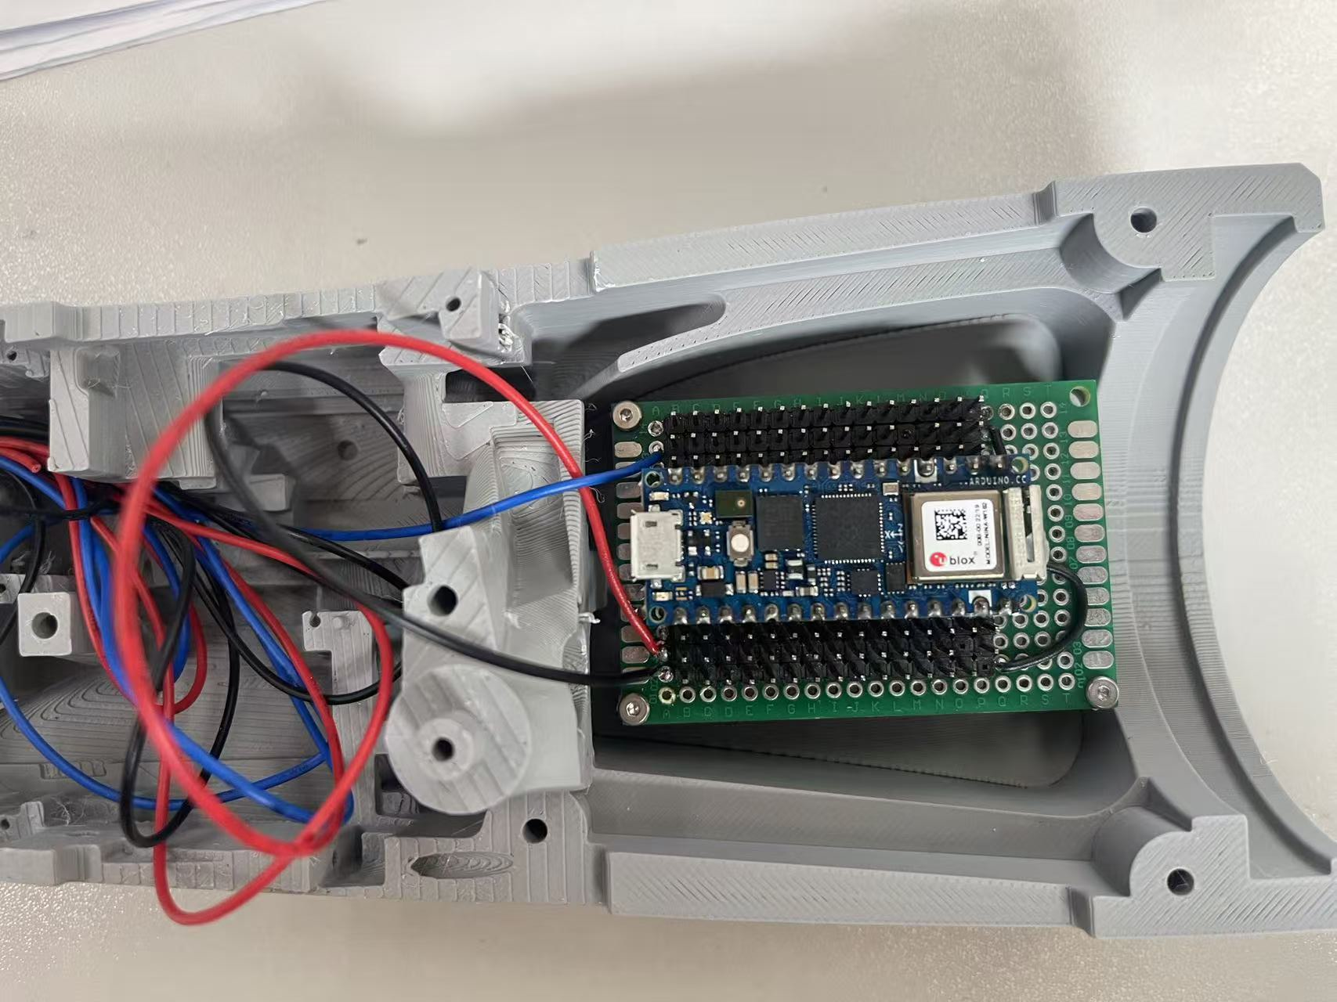
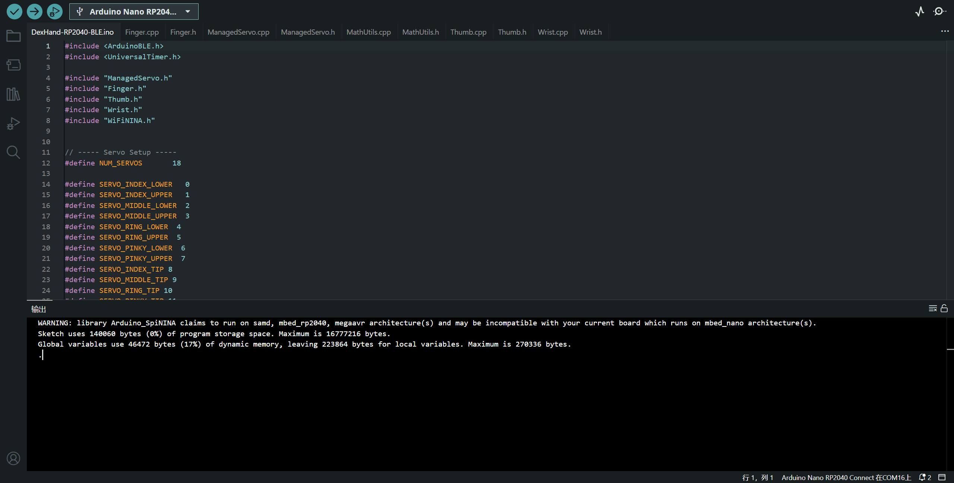
Progress
Electronics and Embedded Testing
Main Control
Completed Work
Completed PCB soldering and control board preparation
Finished firmware flashing for the controller board
Expanded the related circuit connections for hardware testing
Current Status
The control board can be programmed successfully
Basic circuit expansion has been completed
The hardware platform is ready for actuator-level testing
Next Step
Connect the board to the servo system
Verify signal output and actuator response
Continue integrated debugging with the mechanical structure
Assembled control board
Build and upload
Notes:
This slide shows our current progress in electronics and embedded testing. So far, we have completed the PCB soldering and the preparation of the control board. We have also finished firmware flashing for the controller board and expanded the related circuit connections for hardware testing.
At the current stage, the control board can be programmed successfully, and the basic circuit expansion has already been completed. This means that the hardware platform is now ready for the next stage of actuator-level testing.
Our next step is to connect the board to the servo system, verify the signal output and actuator response, and continue the integrated debugging together with the mechanical structure.

Slide 6
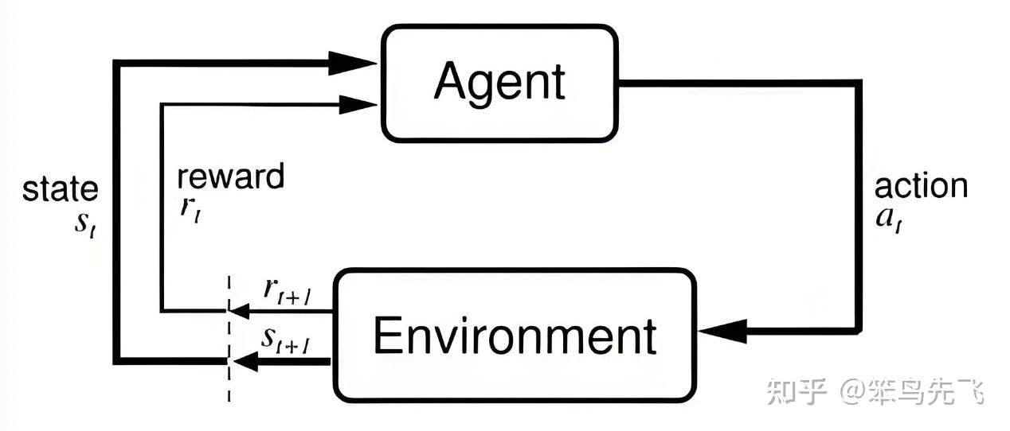

Progress
RL Learning and Environment Setup
RL Learning
Studying the basic concepts of reinforcement learning
Learning the formulation of state, action, and reward
Reviewing RL workflows for dexterous hand control
Environment Setup
Started building the simulation environment in MuJoCo
Exported the dexterous hand model from ROS URDF to XML
Next Step
Validate the imported hand model in MuJoCo
Refine the simulation environment for control tasks
Begin preliminary RL-related experiments on hand motion
Basic RL Workflow
ROS URDF
Mujoco Xml
Model Conversion Pipeline
Notes:
This slide shows our current progress in RL learning and environment setup. At this stage, we are first studying the basic concepts of reinforcement learning, especially how to define the state, action, and reward for dexterous hand control.
At the same time, we have started building the simulation environment in MuJoCo. The current workflow is to convert the dexterous hand model from the ROS URDF description into the MuJoCo XML format, and then import the converted model into MuJoCo.
This provides the foundation for later validation of the hand model, environment refinement, and preliminary RL experiments for hand motion control.

Slide 7
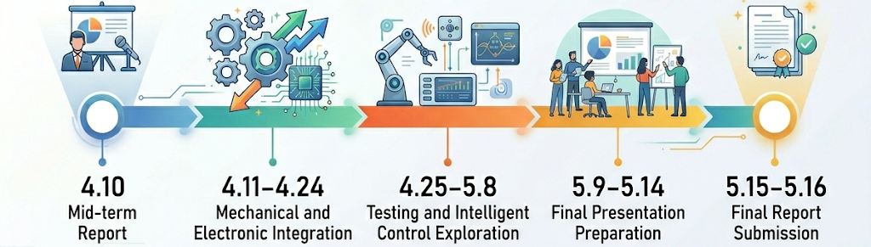
Future work
Next Step Plan & Expected Final Outcomes
Work Area | Planned Tasks
Mechanical | Complete the full hand assembly; finish tendon routing and joint adjustment
Electronics | Continue control board and actuator testing; integrate the servo system with the hardware platform
RL / Intelligent Control | Validate the MuJoCo model; refine the environment for later intelligent control exploration
Outcome Area | Target Result
Hand Prototype | A functional dexterous hand prototype with integrated mechanical and electronic modules
System Verification | Verified actuator control and basic hand motion capability
Simulation-to-Hardware | Initial validation of the DexHand workflow from simulation to physical implementation
Notes:
This slide summarizes our next step plan and expected final outcomes. In the next stage, we will continue working on three areas: mechanical assembly, electronics integration, and RL or intelligent control exploration.
Our expected outcome is to build a functional dexterous hand prototype, verify basic actuator control and hand motion, and complete an initial simulation-to-hardware validation of the DexHand workflow.
The timeline below shows the remaining schedule from the interim report to the final presentation and final report submission.

Slide 8
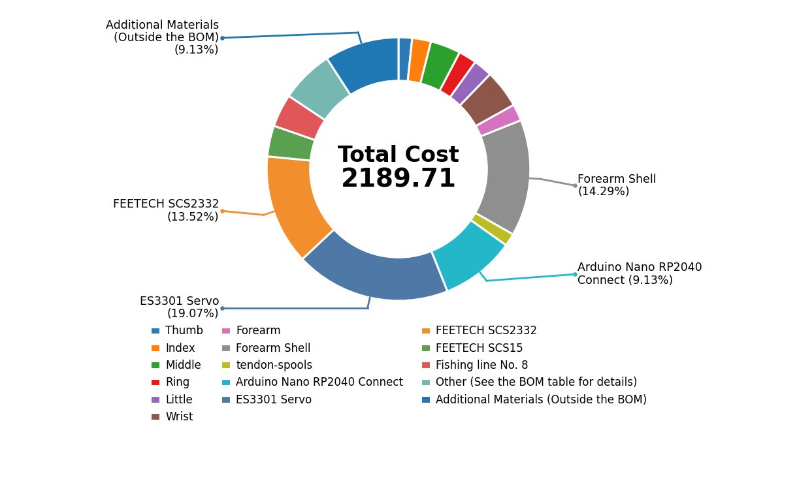
Cost
Material and Progress
Components |  | Cost | Ratio | Satus
Finger | Thumb | 36.41 | 1.66% | Purchased
 | Index | 50.68 | 2.31% | Purchased
 | Middle | 81.34 | 3.71% | Purchased
 | Ring | 48.41 | 2.21% | Purchased
 | Little | 50.77 | 2.32% | Purchased
Wrist |  | 102.67 | 4.67% | Purchased
Forearm |  | 45.05 | 2.06% | Purchased
Forearm Shell |  | 313 | 14.29% | Purchased
tendon-spools |  | 34 | 1.55% | Purchased
Arduino Nano RP2040 Connect |  | 1*200=200 | 9.13% | Purchased
ES3301 Servo |  | 16*26.1=417.6 | 19.07% | Purchased
FEETECH SCS2332 |  | 2*148=296 | 13.52% | Purchased
FEETECH SCS15 |  | 1*83=83 | 3.79% | Purchased
Fishing line No. 8 |  | 1*88.4=88.4 | 4.04% | Purchased
Other (See the BOM table for details) |  | 142.38 | 6.50% | Purchased
Additional Materials (Outside the BOM) |  | About 200 | 9.13% | In Preparation
Total |  | 1989.71+200 | 100%
Other: 4cm*6cm Arduino通用原型板/2.54 排母20pin/2.54 排针20pin/圆柱销套件/M2 螺丝及垫片/螺纹嵌件m2*4*3.5/12编100m灰色/6103滚珠轴承/263滚珠轴承/深沟球轴承6702ZZ/693zz 384/m3*60/m3*70
Notes:
This slide shows our material purchasing progress. Compared with our original plan, we had to buy some extra parts during assembly that were not included in the BOM, which caused an additional cost of around 200 RMB. Overall, all the required parts are now ready. We will try to finish the assembly as soon as possible and then develop different functions based on the dexterous hand.

Slide 9
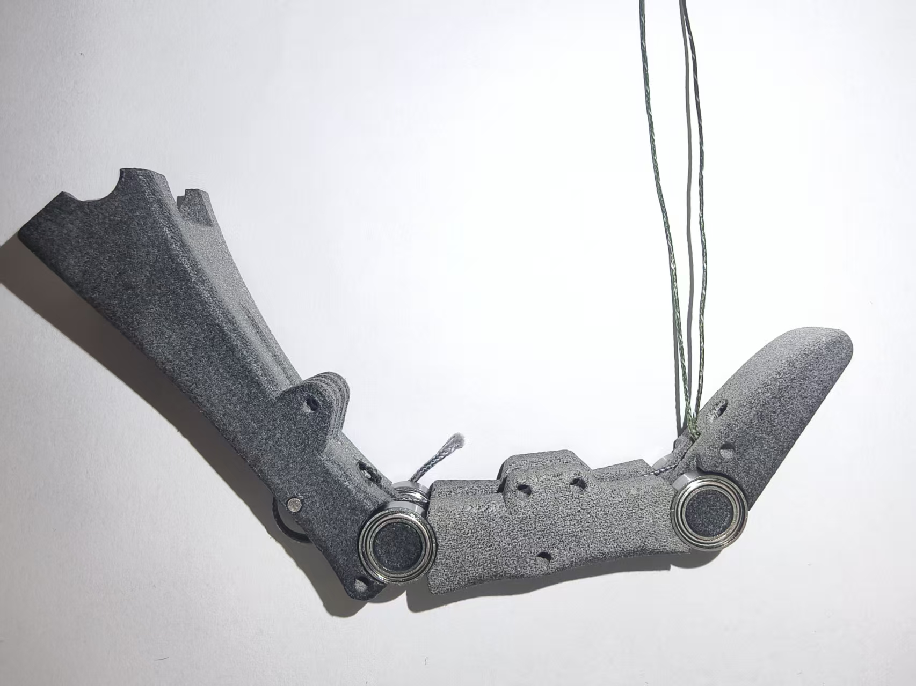
Thank you for listening!
Team Members: Jincheng Tian, GuangTian Liu, ZhongHao Zhao
2026/4/10

